Slide 1
2024-2025 Member Districts
Attala County
Choctaw County
Choctaw Tribal
Clinton
Columbus Municipal
East Jasper
Enterprise
Forest
Hinds
Jackson
Kemper County
Kosciusko
Lauderdale County
Leake County
Louisville
Lowndes
Madison
Meridian
Neshoba County
Newton County
Newton Municipal
Noxubee
Pearl
Philadelphia
Quitman
Rankin County
Scott County
Smith County
Starkville-Oktibbeha
Union City
Vicksburg-Warren
West Point
EMCED Staff
Dr. Ray Morgigno
Executive Director Phone: 601-484-0301
rmorgigno@emced.org
Cythia Pouncey Professional Development Coordinator Phone: 601-484-0302 cythia.pouncey@emced.org
Sherry Gant Business Manager Phone: 601-484-0306 sgant@emced.org
East MS Center for Educational Development, Inc.
Located on the Meridian Campus of Mississippi State University
1000 Highway 19 North Meridian, MS 39307-5799
PH: 601.484.0306
FAX:601.484.0372
www.emced.org
Believing in the Power of Knowledge

Slide 2
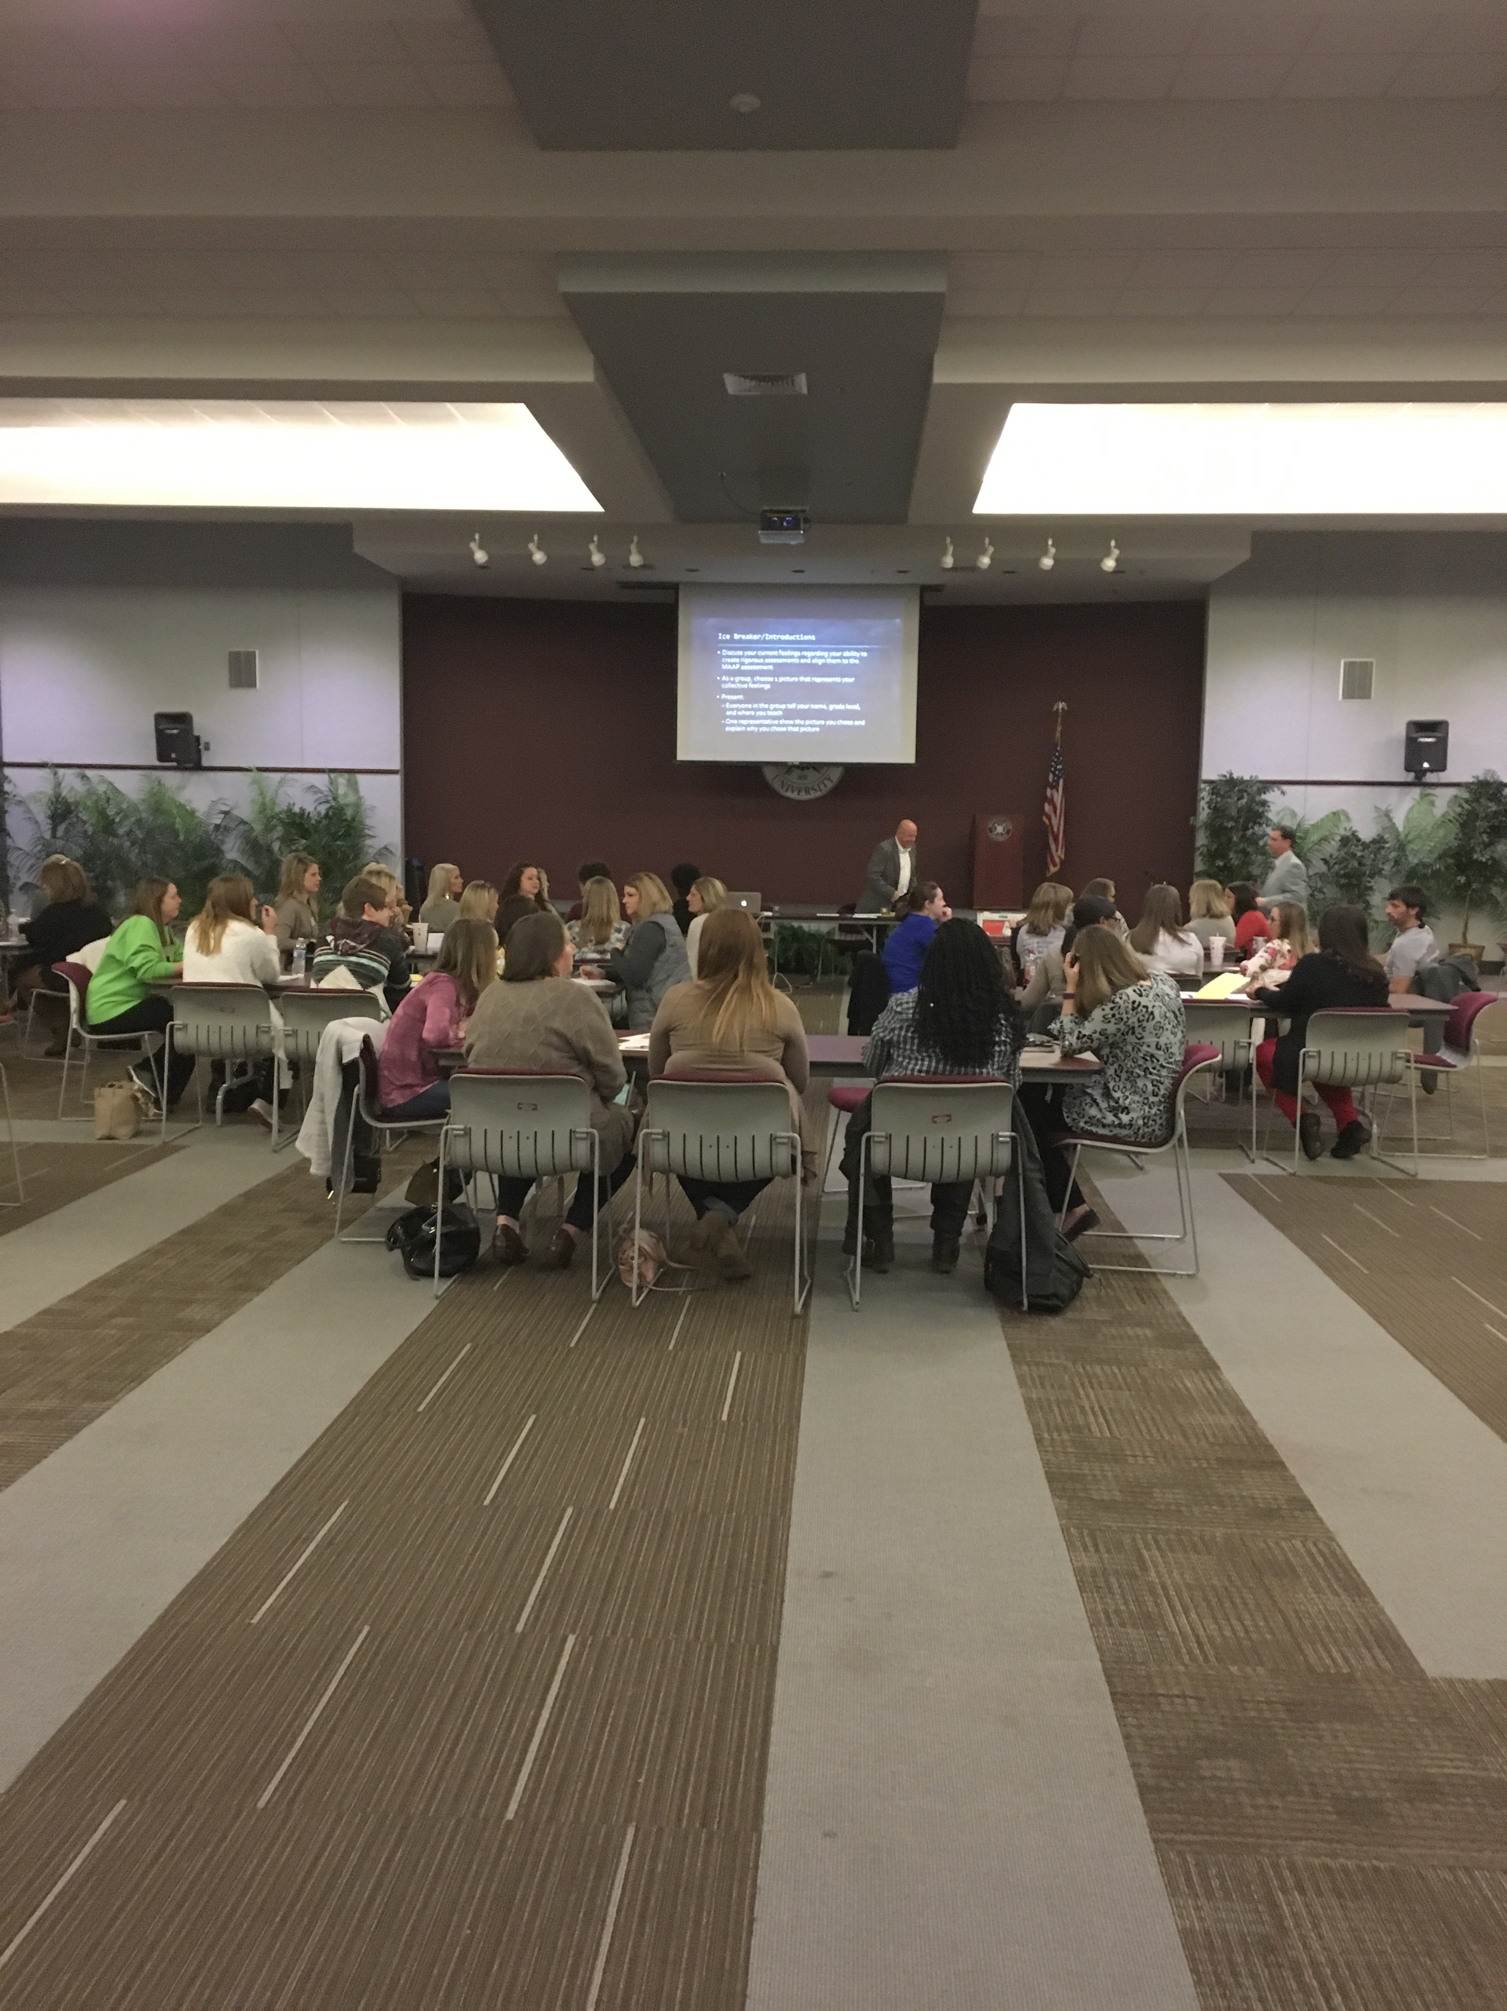
Background Information East Mississippi Center for Educational Development, Inc. (EMCED) is located on the Meridian Campus of Mississippi State University. EMCED serves 30 public school districts across 20 counties in the east Mississippi area. School districts pay an annual membership fee based upon the number of teachers and administrators employed by the member district. EMCED serves an educational community of over 4,800 teachers and 350 administrators. Each year more than 3,000 educators elect to participate in training sessions developed and delivered by EMCED. The consortium is governed by a board of directors comprised of the superintendents of member school districts. An executive committee is elected from the board to oversee the operations of the consortium. The executive director serves as chief executive officer of the consortium and is selected and appointed by the board of directors.
Our Mission EMCED is committed to assuming a strong leadership role in supporting public educators’ efforts to develop quality learning environments in which all children can obtain a quality education. EMCED’s partnership with member school districts and Mississippi State University promotes high-quality instruction in the classroom and overall school improvement by enhancing and improving the personal and professional effectiveness of educators. This is accomplished through high-quality professional development opportunities and support services provided in an efficient and affordable format.
Delivery of Services EMCED concentrates delivery of professional development services through a full range of regional offerings as well as in-district professional development sessions.
All courses offer Continuing Education Units (CEUs) through Mississippi State University.
Area administrators explore communication and team building skills.
Services Offered:
Superintendent/Principal Coaching
Teacher Mentoring/Coaching
Counselor Training
Classroom Management
Safety Training
MSIS Training
Canvas/Google Classroom Training
Strategic Planning
ACT Prep
STEM Training
Technology Training
New Teacher/Leadership Training
Elementary/Secondary Principals Collaborative
Monthly Superintendent's Meetings
Quarterly Network Meetings of SPED Directors, Federal Program Directors, Business Managers & Curriculum Directors
Elementary teacher collaborative

